Slide 1
Acoustic Sensors
Keith Bhebe and David Sebaoun

Slide 2
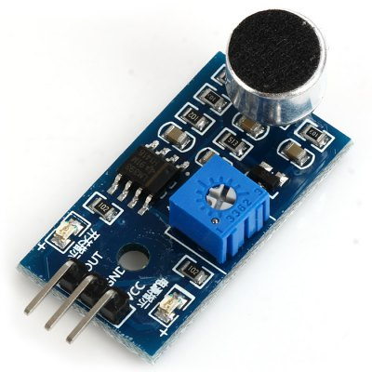
What are acoustic sensors ?
They are commonly known as Microphones
They are pressure transducers
They work over a broad spectral range but often exclude very low frequencies
There are many kinds of microphones with different sensitivity, directional characteristics, frequency bandwidth, dynamic range and size
They all share the same working principles
Notes:
The fundamentals of acoustics are given in Sect. 3.10.

Slide 3

HOW DOES IT WORK?

Slide 4
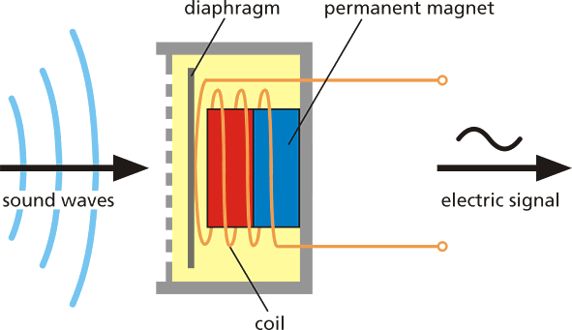
How do acoustic sensors work ?
They are made of 2 essential components :
a moving diaphragm
a displacement transducer that converts the diaphragm’s deflections into an electrical signal
Notes:
The fundamentals of acoustics are given in Sect. 3.10.

Slide 5
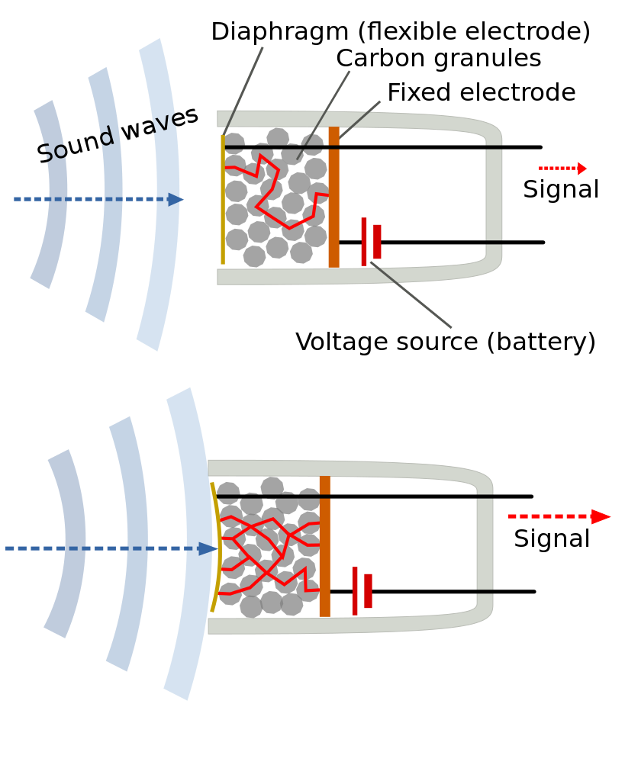
Resistive Microphones
Made of a capsule full of carbon granules in between to metal plates
Voltage is applied across the metal plates and a small current flows through the carbon
One of the plates acts as a diaphragm
The change of pressure deforms the carbon granules, this changes the contact area between the granules and the plates which results in a change of electrical resistance

Slide 6
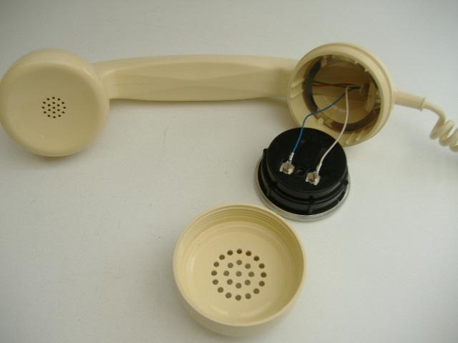
Resistive Microphones

Slide 7
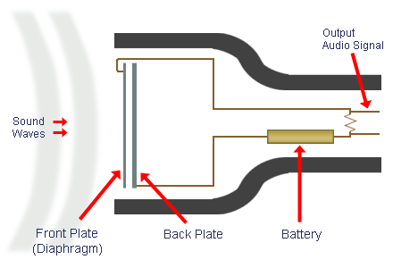
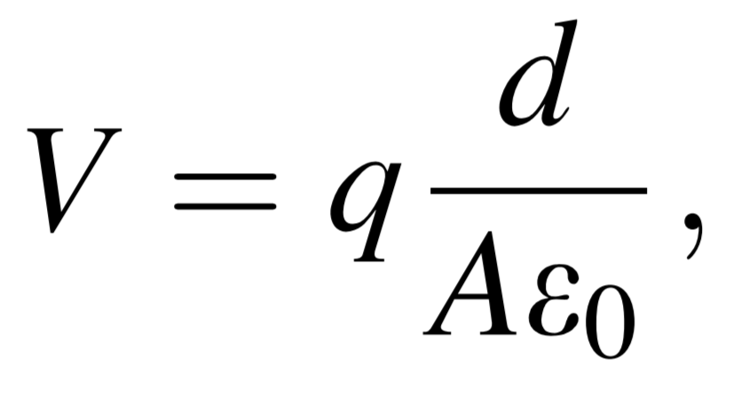
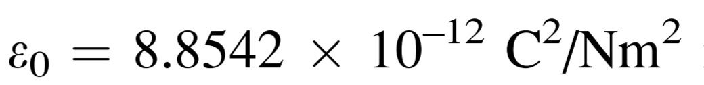
Condenser Microphones
They are made of two parallel-plate capacitors
The vibrations of the plate used as a diaphragm changes the distance between the two plates
When the distance changes, the voltage going through the two plates changes
That voltage can be described as
Notes:
The equation is the basis for operation on condenser microphones
q electric charge applied to the plates
d the distance between the two plates
A the area of the plates
Eo the permittivity constant

Slide 8
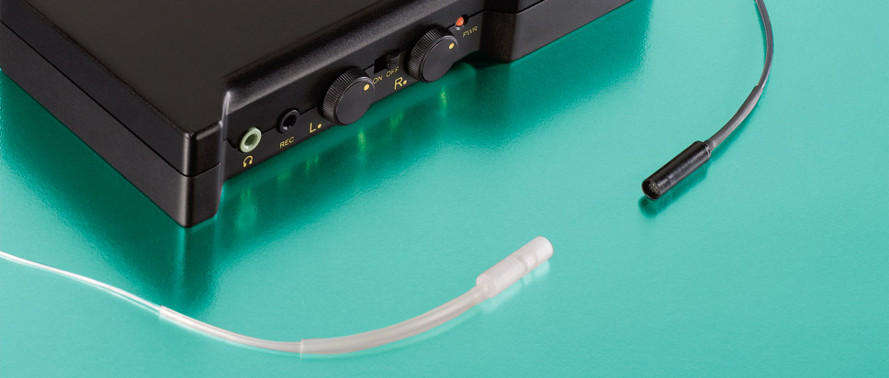
Fibre-Optic Microphones
They are used in hostile environments : turbojets, rocket engines, etc…
They are made to withstand high temperatures and strong vibrations
Some of them are watercooled ex: in rocket engines

Slide 9
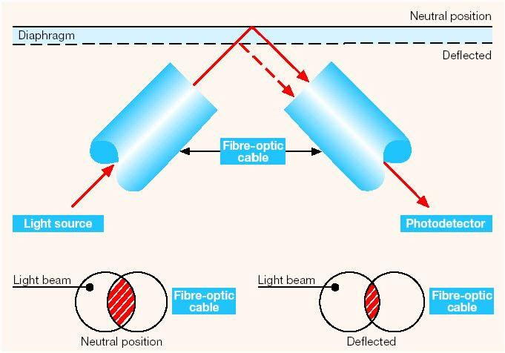
Fibre-Optic Microphones
6 parts :
A laser light source
Two fibre-optic cables that are fused together
A diaphragm
A mirror
A cleaved plate
A photodetector

Slide 10
Fibre-Optic Microphones
Light is sent in the input fibre-optic cable
It hits the cleaved plane and part of it is reflected while the other one hits the mirror on the diaphragm and is also reflected
Those two beams go through the output fibre-optic cable and interfere with each other
The intensity of the light coming out of the output fibre-optic cable is measured by the photodetector

Slide 11
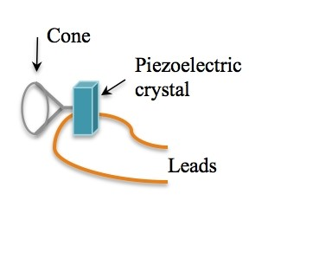
Piezoelectric Microphones
A crystal microphone or piezo microphone uses the phenomenon of piezoelectricity—the ability of some materials to produce a voltage when subjected to pressure—to convert vibrations into an electrical signal.
Vocal sound waves vibrate air particles which carry the wave through the air. On entering the microphone, the sound waves meet a diaphragm which in turn vibrates at the same frequency. The diaphragm is connected to the crystal. When the vibrations reach a piezoelectric crystal energy is transferred, thus causing small stresses to be placed on the crystal.

Slide 12
HOW DOES IT WORK?

Slide 13
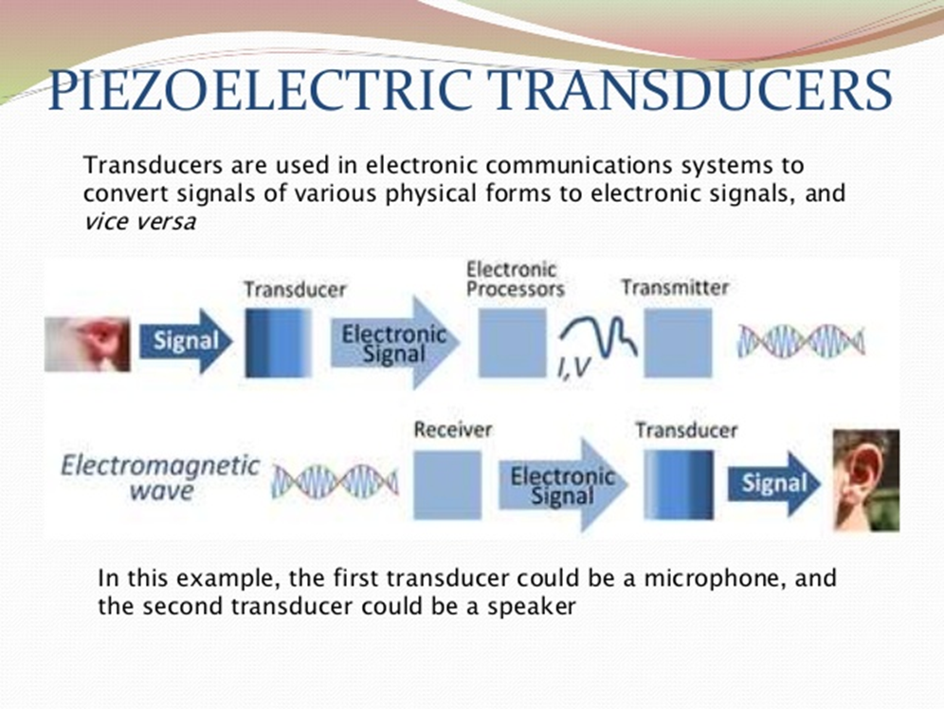
How it works!!

Slide 14
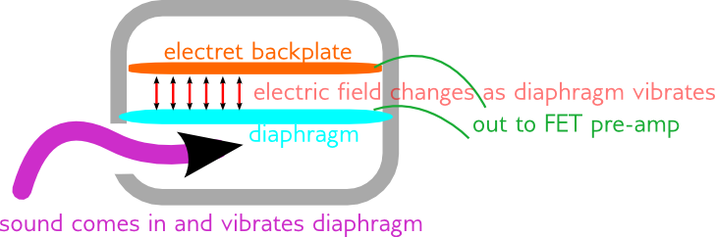
Electret Microphones
It uses two conducting plates; one is fixed while the other is a vibrating diaphragm.
With the diaphragm and the back plate ready to receive sound waves, they work by letting the incoming sound waves from a source of sound from any direction to change the capacitance between the two conducting plates.
The diaphragm is the conducting plate that receives the sound waves and it causes the change in capacitance.

Slide 15
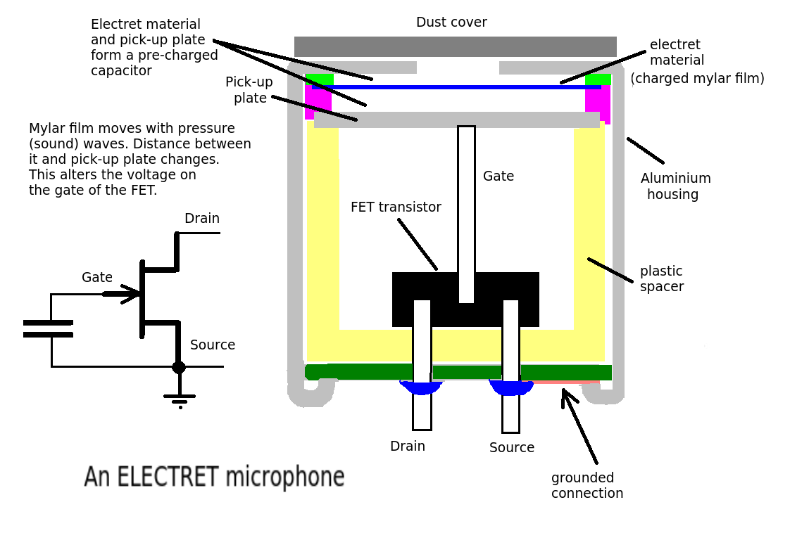

Slide 16
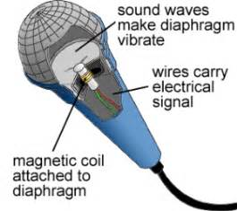
Dynamic Microphones
A small movable induction coil, positioned in the magnetic field of a permanent magnet, is attached to the diaphragm.
When sound enters through the windscreen of the microphone, the sound wave moves the diaphragm. When the diaphragm vibrates, the coil moves in the magnetic field, producing a varying current in the coil through electromagnetic induction.

Slide 17

Patti Smith singing into a Shure SM58 (dynamic cardioid type) microphone

Slide 18
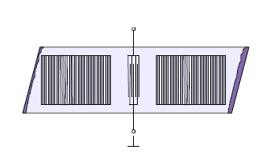
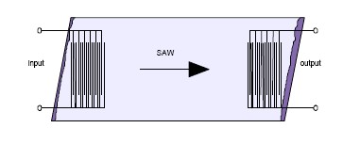
Solid-State Acoustic Detectors
A typical acoustic wave device consists of two sets of interdigital transducers. One transducer converts electric field energy into mechanical wave energy; the other converts the mechanical energy back into an electric field.

Slide 19
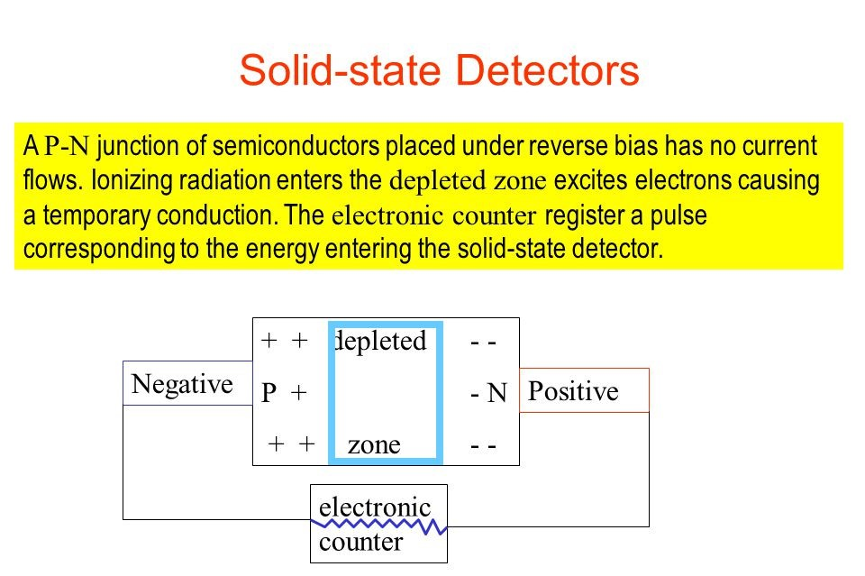

Slide 20


